Slide 1
Forecasting at Scale using FBProphet in Python
Nikolaus Herjuno Sapto Dwi Atmojo

Slide 2




Nikolaus Herjuno Sapto Dwi Atmojo
Traveloka (September 2019 - Present)
Data Analyst for Bill Payment & Payment (September 2019 - December 2019)
Data Analyst for PayLater (December 2019 - Present)
Tokopedia (September 2017 - Aug 2019)
Data Analyst for Operations
Jakarta Smart City (June 2016 - Aug 2016)
Data Scientist Internship
Institut Teknologi Sepuluh November (2013 - 2017)
Information Systems 2013

Slide 3
What does it mean “at scale” ?

Slide 4
Forecasting “at scale” is 25% a technology problem
and 75% a people problem

Slide 5
What’s FBProphet ?
Prophet is based on an additive model where non-linear trends are fit with yearly, weekly, and daily seasonality, plus holiday effects.
It works best with time series that have strong seasonal effects and several seasons of historical data. Facebook claims that Prophet is robust to missing data and shifts in the trend, and typically handles outliers well

Slide 6
Problems
Many applications that require forecast
Single metric can be forecasted numerous times (eg. each country, ..)
Not many people have forecasting training
Not many existing tool

Slide 7
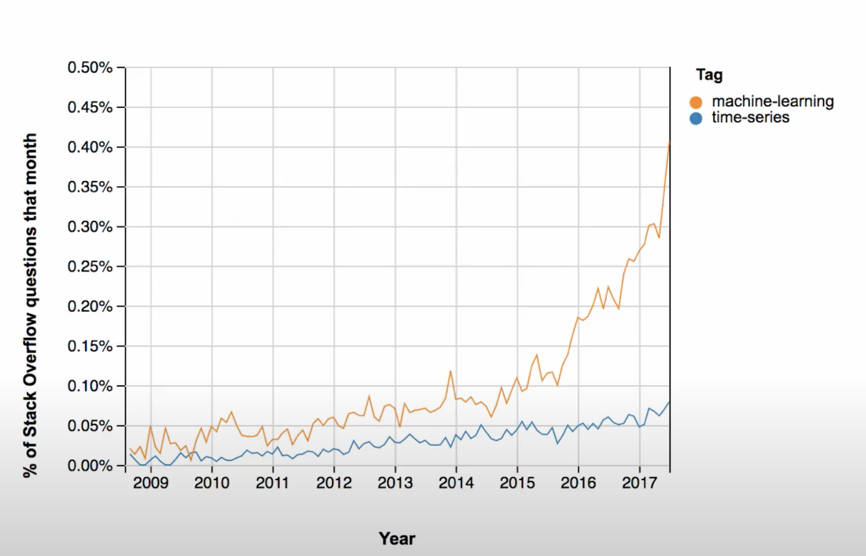
Machine Learning vs Time Series Trend
Source : http://insights.stackoverflow.com/trends

Slide 8
Why was FBProphet developed at the first place ?
(semi) automated forecasting :
Find similarities across of forecasting problem
Build a tool that can solve most of the forecasting problem
Make it easy to use and teach everyone to use it
Offer advanced features when necessary

Slide 9
Why was FBProphet developed at the first place ?
(semi) automated forecasting :
Find similarities across of forecasting problem
Build a tool that can solve most of the forecasting problem
Make it easy to use and teach everyone to use it
Offer advanced features when necessary

Slide 10
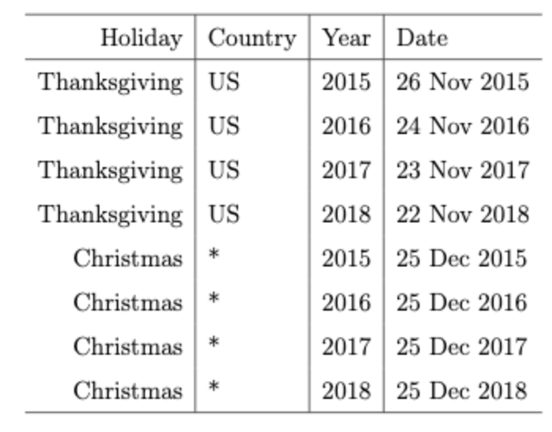
FBProphet is decomposed time series model
y(t) : piecewise_trend(t) + seasonality(t) + holiday_effect(t) + noise
Saturating growth model
Piecewise linear model
Automatic Changepoints Selection
Trend forecast uncertainty
provides a adaptability to the model by allowing periodic changes based on sub-daily, daily, weekly and yearly seasonality
Reference : The Math of Prophet - Future Vision

Slide 11
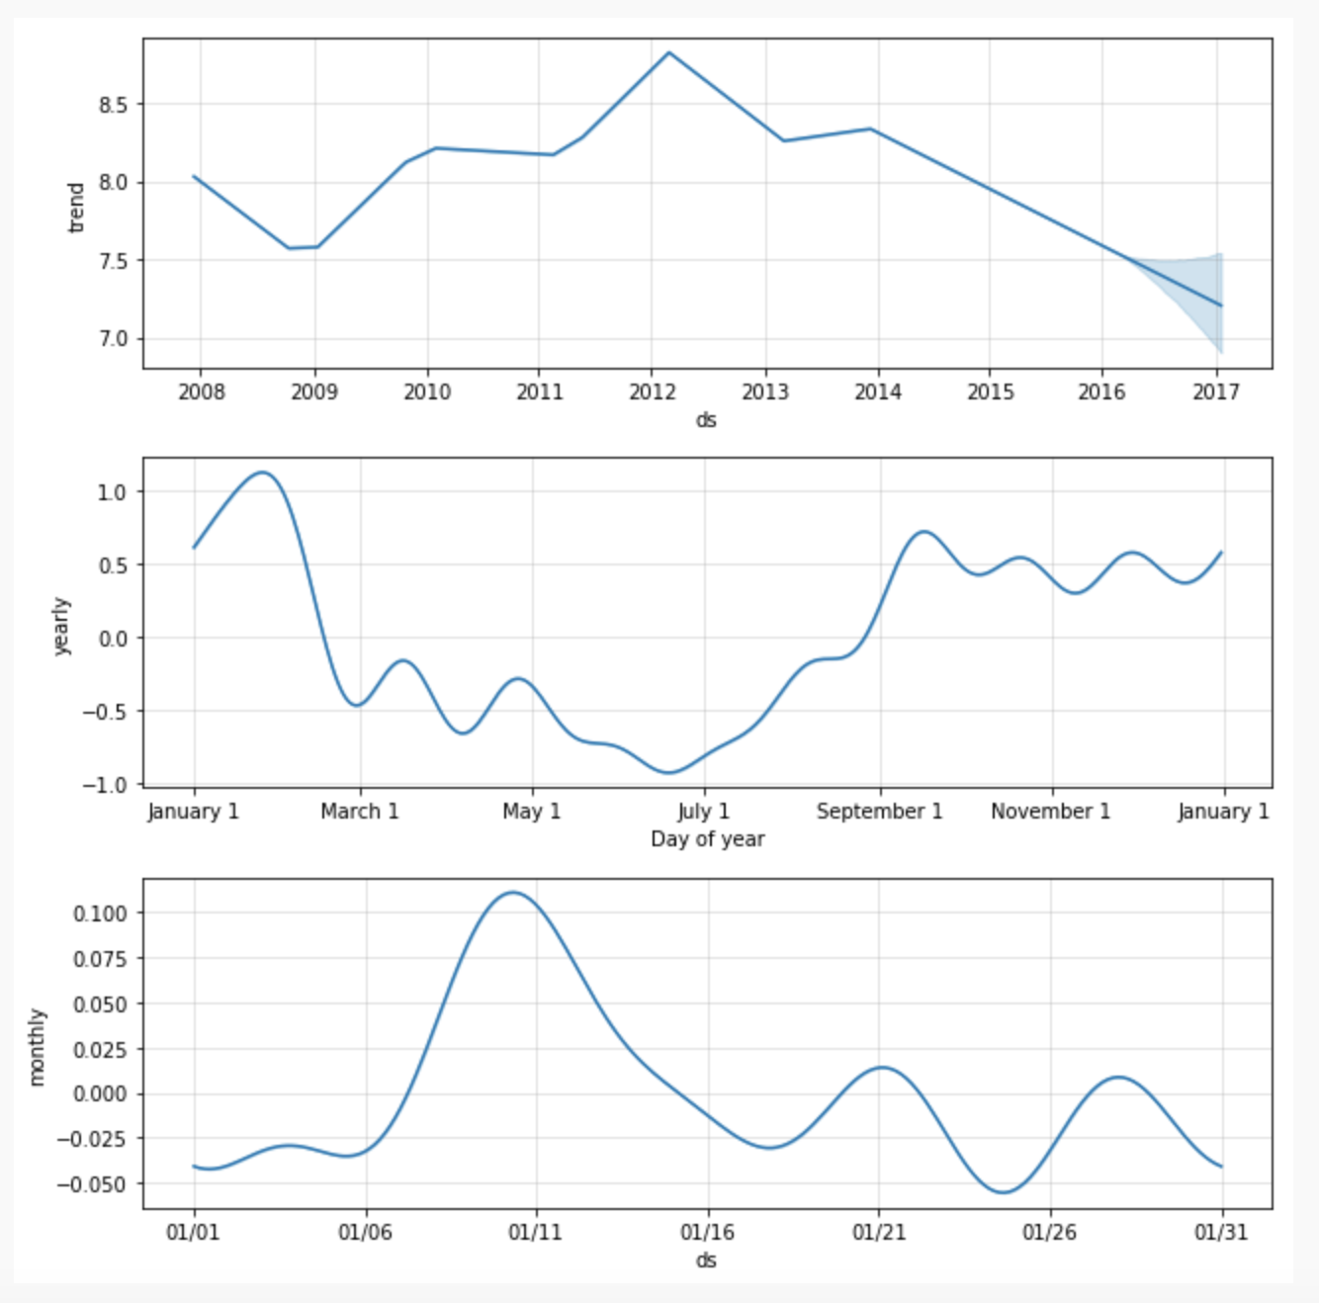
Forecast Component
Split single model of forecast to tell us the trend on yearly, monthly, day or even in hour unit level in descriptive way

Slide 12
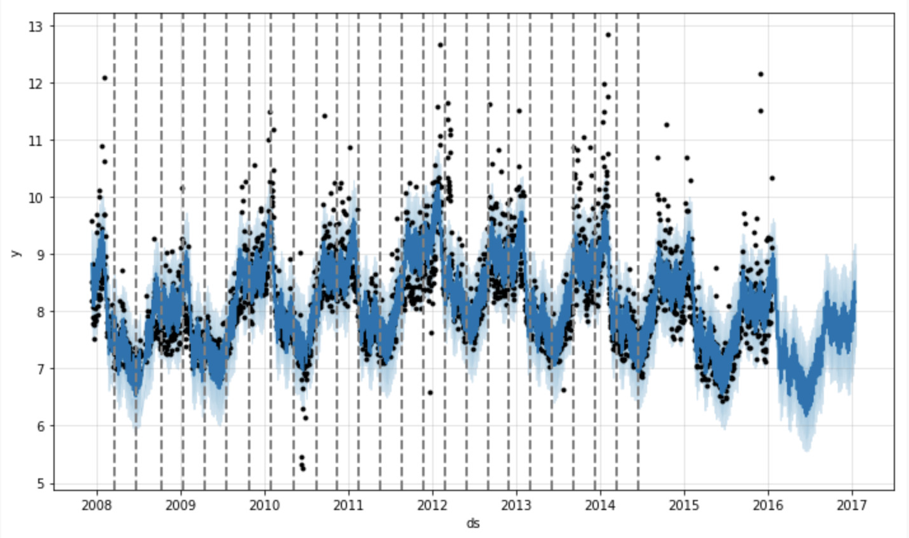
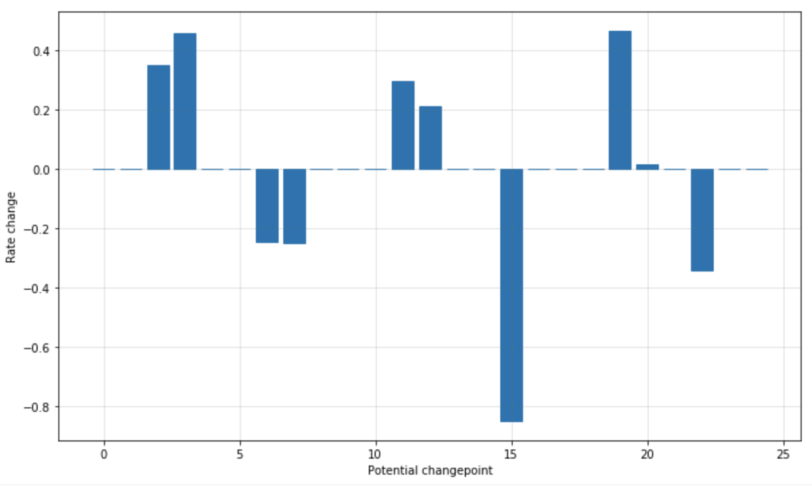
Trend changepoints
Prophet detects changepoints by first specifying a large number of potential changepoints at which the rate is allowed to change. It then puts a sparse prior on the magnitudes of the rate changes (equivalent to L1 regularization)
~ Laplace
Fit : Estimate trend change distribution
Estimate : Sample future trend change from distribution
Reference : The Math of Prophet - Future Vision

Slide 13
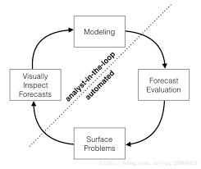

Knobs and Lever
Priors and seasonality parameter
Priors on how often we expect changepoints
Functional form of growth (piecewise linear and logistics)
Covariates and holiday
Custom seasonalities
MAP and full posterior

Slide 14
Conclusion
Prophet was developed to close the skill gap and help analysts with a variety of backgrounds produce more forecasts with less time invested towards doing so. This was achieved by sticking to a relatively plain mode
If you have some of free time, please watch this video, it will gives you some insights regarding Prophet : Forecasting at Scale: How and Why We Developed Prophet for Forecasting at Facebook

Slide 15
Let’s practice together ! ;)
Google Colab

